Slide 1
Perspectives of an Occupational Medicine Physician April 12, 2023
Burton Abbott, BMR(PT), B.Sc., MD, CCFP(EM)(COE), ACBOM
Assistant Professor, Dept. of Emergency Medicine, University of Manitoba
Emergency Physician
Occupational Medicine Physician

Slide 2
Disclosure
Over the years, I have been remunerated by:
Manitoba Health (and WRHA, IERHA, SH, PMH)
Manitoba Public Insurance
Workers Compensation Board of MB
Medical Services Plan of BC
Insurance Corporation of BC
University of Manitoba
Pure Lifestyle Inc.
Notes:
I

Slide 3
Disclosure
Opinions presented are solely mine. Opinions expressed today do not represent the views of any organization with whom I am affiliated or have been affiliated.
None of the organizations with whom I am affiliated or have been affiliated have remunerated me for today’s presentation or its preparation.
I am not trying to sell you any product or service today.

Slide 4
My Background

Slide 5
Outline
Commenting on Ability to Work
Caution When Data is Presented
Blackbox Warning
What Am I Looking for in a Rehabilitation Program?

Slide 6
One Item to Ponder
Although we have different perspectives and there may differences of opinion, everybody has one goal in common:
All parties want an individual affected by illness or injury to have highest possible level of function and best quality of life.

Slide 7
Can Mr. Smith Return to Work
The parameters to consider when commenting on ability to return to a work place are:
Risk
Capacity
Tolerance

Slide 8
Risk
The probability of harm to the individual, co-workers or members of society that occurs with a return to the activity in question.
Depends on the condition and the job
Seizure disorder vs. lumbar spine osteoarthritis
Pilot vs. office worker
Notes:
Implied that the risk of harm is over and above baseline risk inherent in the job

Slide 9
Capacity
This variable refers to objective measures that would lead to a limitation in terms of performing a task.
Visual acuity
Cognition
Strength*
Lung function
Ejection fraction

Slide 10
Tolerance
A subjective variable that cannot be objectively measured
The willingness of an individual to tolerate symptoms (e.g. pain, fatigue) in order to gain the benefits that arise out of performing a task

Slide 11
Some points to ponder
All three issues are important when considering return to work
Risk and capacity may improve with further treatment
Seizure disorder
Weakness
Tolerance generally improves with return to work including graduated return to work

Slide 12
Some points to ponder
With benign conditions (e.g. back pain, osteoarthritis), tolerance is most often the issue.
Care providers often assert that the issue is risk or capacity when the issue is tolerance.
Clarity in terms of risk, capacity or tolerance is critical.
Risk – the issue in question must be addressed
Capacity – often amenable to treatment
Tolerance – will generally improve with (graduated) RTW

Slide 13
Tolerance
If the issue is tolerance, this variable will not improve with the passage of time and with a longer period of inactivity. It will likely worsen.
If the issue is tolerance, generally the best course of action involves a (graduated) return to activity.

Slide 14
Does the data represent pathology?

Slide 15
Clinical Data
Right leg strength: Ankle PF and DF 4/5, knee flexion 4/5, knee extension 3/5, hip flexion 4/5

Slide 16
EMS and Emergency Dept: “no loss of consciousness”
Family MD: ”sustained a loss of consciousness lasting 3 hours”
Specialist MD #1:
Specialist MD #2:

Slide 17
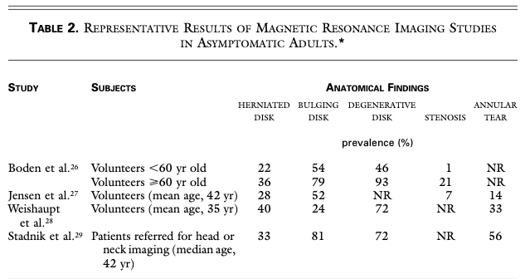
Clinical Data
Deyo RA, Weinstein JN. N Engl J Med. 2001 Feb 1;344(5):363-70

Slide 18
The Grey Hair of the Spine

Slide 19
Ask yourself, does the data represent pathology?

Slide 20
Clinical Data
There is a lot of subjectivity in ”objective data”
Before ordering a test, the clinician should have an idea regarding:
sensitivity/specificity of the test
what to do with possible outcomes
what is in the differential diagnosis

Slide 22
Black Box Warning
Would you take a medication that:
Has no proven benefit
Is well established to be harmful to physical health, mental health and social well-being

Slide 23
“My Doc just gave me a note for 2 weeks off work”
Good or bad news?
Is there evidence?

Slide 24
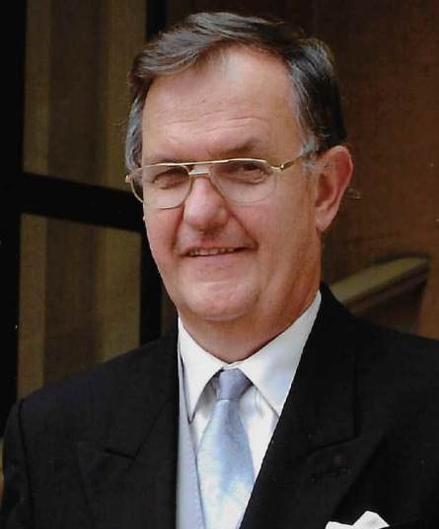
Professor Gordon Waddell 1942-2017: Orthopaedic surgeon, academic and author
Standard advice of bed rest was incorrect
Over-reliance on surgery as a treatment
Message that anything that causes pain must be avoided was wrong

Slide 25
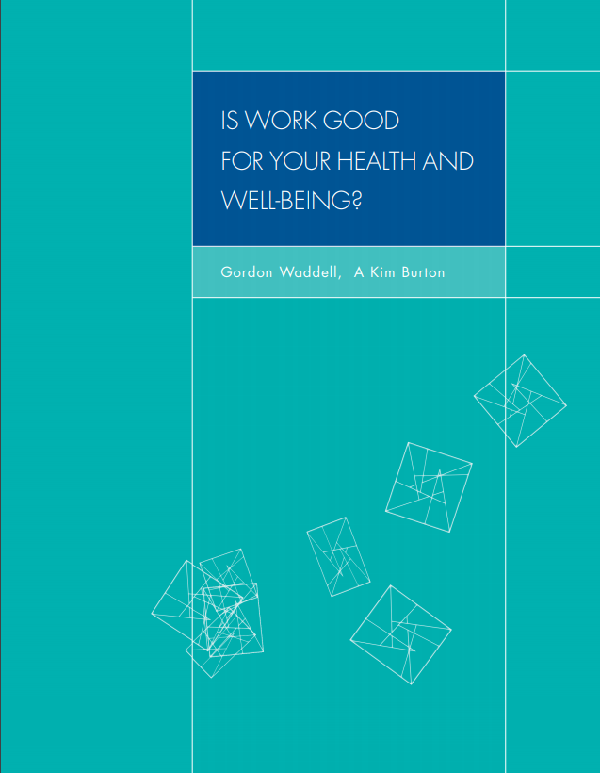

Slide 26
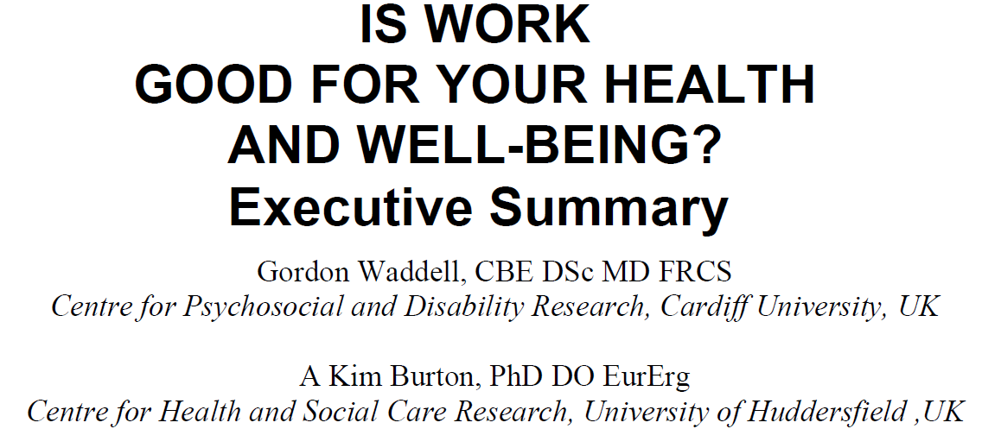
Notes:
This review was commissioned by the UK Department of Work and Pensions.
Independent review of the scientific evidence.

Slide 27
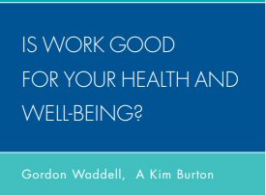
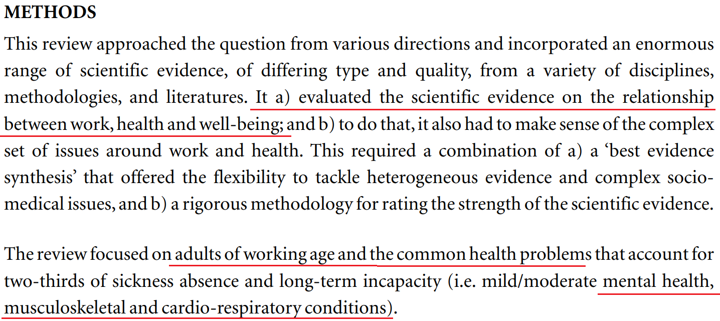

Slide 28
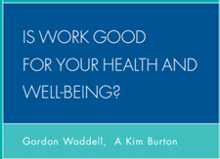
Sample of Conclusions:
People with muscle and joint pain who are helped (by their health advisor and employer) to return to work tend to enjoy better health (level of pain, function and quality of life) than those who stay off work.
When their health condition permits, people who are sick and disabled should remain in or return to work as soon as possible because it's therapeutic, helps to promote recovery and rehabilitation, and reduces the risk of long-term incapacity.
The risk of a stress or depression-type condition getting worse at work are outweighed by the beneficial effects of employment on wellbeing, and the likely negative impact of long-term sick leave.

Slide 29
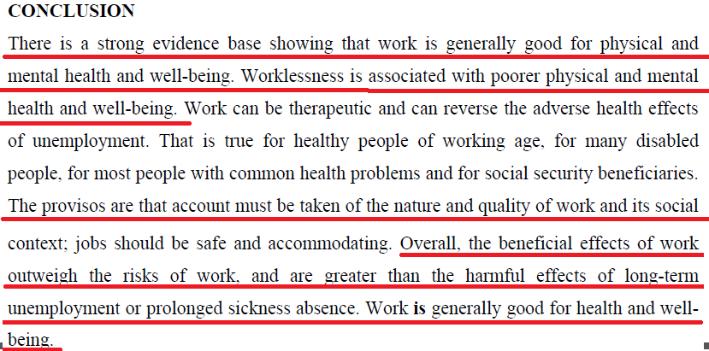

Slide 30
This review has demonstrated a strong scientific evidence basis for helping someone with a health problem stay at, return to and remain work.

Slide 31
“Return-to-work should be one of key outcome measures of any intervention.”
“Healthcare has a key role, but vocational rehabilitation is not a matter of healthcare alone – the evidence shows that treatment by itself has little impact on work outcomes.”

Slide 32
“Overall, …effective vocational rehabilitation depends on work-focused healthcare and accommodating workplaces. Both are necessary: they are inter-dependent and must be coordinated.”
“Effective vocational rehabilitation depends on communication and coordination between the key players – particularly the individual, healthcare, and the workplace.”

Slide 33
Gordon Waddell
“…long term worklessness is one of the greatest risks to health in our society. It is more dangerous than the most dangerous jobs in the construction industry, or [working on an oil rig in] the North Sea, and too often we not only fail to protect our patients from long term worklessness, we sometimes actually push them into it, inadvertently..

Slide 34
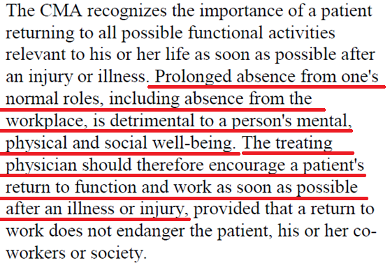

Slide 35
JOEM Volume 59, Number 6, June 2017
“The personal physician has a role in assisting patients minimize life and work disruption resulting from new injury or illness… This means…for working patients, helping them stay at work or return to work as soon as it is medically viable.
In order to discharge these responsibilities appropriately, it is important that physicians appreciate the importance of work to human life and well-being…”

Slide 36
JOEM Volume 59, Number 6, June 2017
“…While paying attention to occupational issues may require extra time and effort on the physician’s part, it is vital to the patient’s wellbeing. The physician who does this will enhance patients’ medical and functional outcomes, prevent medically needless work disability, and help patients stay employed.
Keeping a patient employed not only benefits that individual but also has a positive impact on the patient’s family, community, employer, and society in general.”

Slide 37
General Considerations Regarding Return-to-work (RTW)
“Medically unnecessary delays in RTW must be avoided because employment is an important determinant of health and unsuccessful RTW can have profound negative economic and psychosocial consequences for affected individuals.”

Slide 38
General Considerations Regarding Return-to-work (RTW)
“Specific to concussion/mTBI, workers with brain injury who are employed report better health status, improved sense of well-being, greater social integration within the community, less usage of health services and a better quality of life compared to those who remain unemployed.”

Slide 39
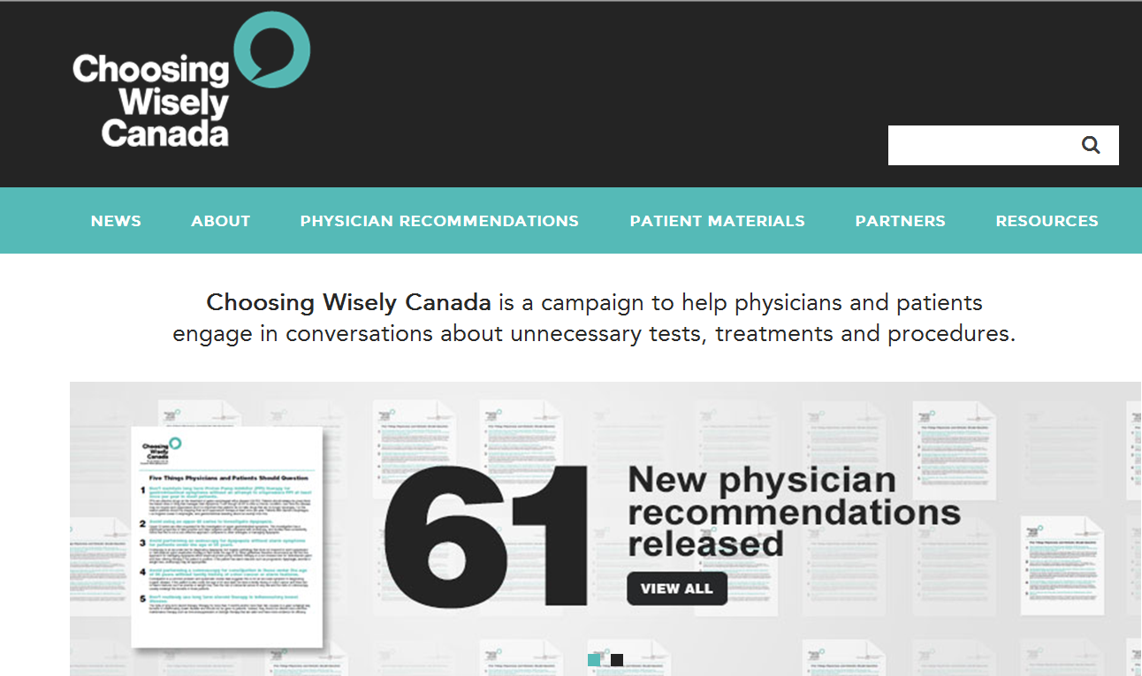
http://www.choosingwiselycanada.org/

Slide 42
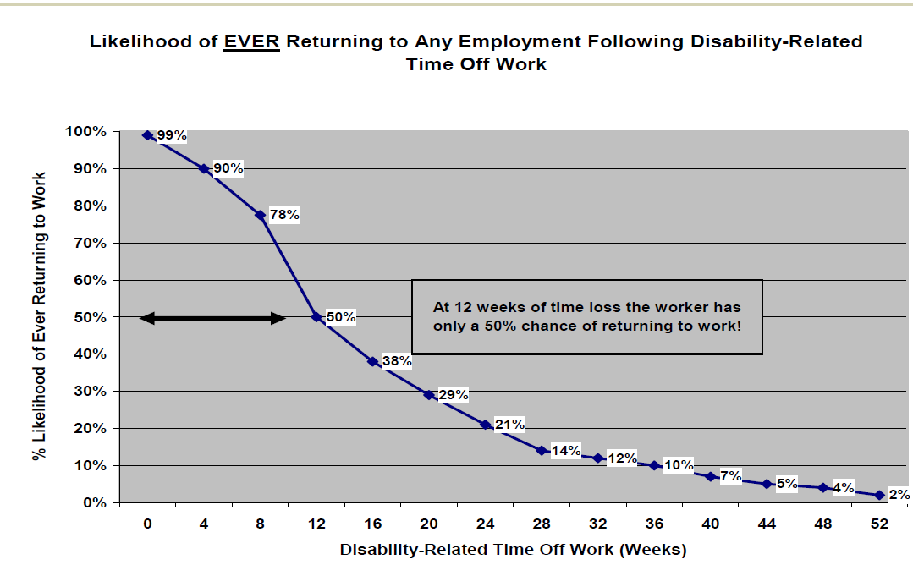

Slide 43
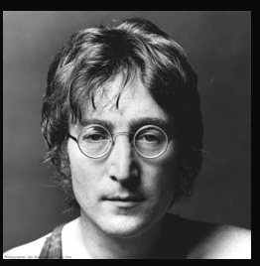

Slide 44
So we all agree…

Slide 45
So why the following reporting?

Slide 46
Subjective: “Left upper back pain”
Objective: “Tenderness over left upper back”
Treatment plan: ”Rest, two weeks off work, muscle relaxant… cold/hot packs”

Slide 47
Is your patient able to participate in a vocational rehabilitation program…toward a gradual return to…own occupation?” NO
Is your patient medically able to participate in a vocational rehabilitation program…toward an alternate suitable occupation?” NO

Slide 48
Will a return to the workplace adversely affect the natural history of the client’s condition? YES
Does the patient’s clinical condition post a safety/health risk to the patient or… co-workers YES
Does this condition post a safety risk to operating a motor vehicle? NO

Slide 51
So why do we do this?
Notes:
This would be like if:
All the evidence said to not speed but the experts counseled us to speed
All the evidence said to use our seat belt but the experts counseled us to not use our seat belt.
All the evidence said to not drink and drive but the experts counseled us to drink and drive

Slide 52
The advice given by care providers is a reflection of our society. This is all of us.

Slide 54
What Am I Looking for in a Rehabilitation Program?
Is a rehabilitation program necessary?
Is the primary problem physical or psychological?
Activity progression must be the centrepiece
Criteria for progression must be function based not symptom based.
The highest possible level of function is the expectation
No misinformation
No catastrophic language

Slide 55
What Am I Looking for in a Rehabilitation Program?
Don’t over-medicalize
The rehabilitation professional cannot be deferential to the physician involving rehabilitation
The treatment can’t be too allopathic
If the condition is not improving consistent with the natural history:
Reconsider the diagnosis
Is there a persisting physical condition?
Stop treatments not associated with objective functional improvement

Slide 56
Take Home Messages
We all want the best for the person with injury or illness
Is the primary issue risk, capacity or tolerance?
Advising people to stay away from work is associated with psychological and medical risk
Carefully consider the risks/benefits
Rehabilitation should be active, evidence based and should avoid “medicalizing” the individual

