Slide 1
Occupational Therapy and Mental Health
Helping Clients with Mental Health Concerns Return to Work
Kale Lutomsky
Subcontracted Occupational Therapist
Notes:
Ever worked with or have referred a client to an OT
MH OT?
How many of you work in mental health?

Slide 2
Roadmap
Today, we will cover:
What is OT?
What role the OT has in supporting their client’s mental health
Common assessments used by mental health OTs
Common interventions used by mental health OTs
Application of assessment and intervention techniques to a clinical example

Slide 3
What even is “Occupational Therapy?”
Canadian Association of Occupational Therapists (2022):
Occupational Therapy is a type of health care that helps to solve the problems that interfere with a person’s ability to do the things that are important to them – everyday things like:
* Self-care - getting dressed, eating, moving around the house,
* Being productive - going to work or school, participating in the community, and
* Leisure activities - sports, gardening, social activities.
I have a lot to think about
=
Notes:
Broad skillset, broad job duties, broad focus

Slide 4
What even is “Occupational Therapy?”
It’s more helpful to ask:
What does an OT in mental health do?
What does an OT in the school system do?
What does an OT in the hospital do?
Notes:
Not all MH OTs are the same
Brief work hx to describe trainings:
MI workshops (2)
DBT workshops (2)
CBT workshop (1)

Slide 5
What even is “Occupational Therapy?”
For OTs, the goal is always to assist the client return to some level of independent function,
i.e. increase the client’s ability to complete self-care, productivity, and leisure tasks…
HOW we do this depends on:
A) the setting
B) the client’s concerns
C) the OT’s extra training / previous experience

Slide 6
What we’re good at…
Our schooling and practicums give us:
Background in anatomy, physiology, psychology / mental health, and statistics / research
Background in mental and physical health counselling and rehab
Extensive experience breaking-down tasks (or as we call them “occupations”) to better understand the sensation, cognitive, perceptual, affective, and motor performance components of any given task. (We then use these “tasks” or “occupations” as a way to assess and treat!)
Notes:
Give an overview
The last point, I believe, is our biggest asset: The rigorous training OTs have in assessing and understanding a client / given client concern.
THIS ALLOWS US TO BETTER UNDERSTAND where our clients are "getting stuck", and help them strategize through.

Slide 7
My focus with mental health clients:
Cognition Affect
Notes:
Talk about cog and affect here

Slide 8
Affect and Cognition: Assessment
To assess these two huge domains, a mental health OT could use the following assessments:
Affective:
Overall status: Personal Recovery Outcome Measure (PROM), Mental Status Examination (MSE)
APA DSM-5 Severity Measures: General anxiety, separation anxiety, social anxiety, PTSD, agoraphobia, panic, depression, acute stress, etc.
Self-efficacy scales: General, Pain, Cognition, RTW
Depression: Beck’s, PHQ-9
Fatigue: Mental Fatigue Scale
Fear: Fear-Avoidance Beliefs Questionnaire (FABQ), Tampa Scale for Kinesiophobia
QOL: WHO QOL, WHO Disability Assessment
Cognitive
Adult Executive Functioning Inventory (ADEXI) - self report and other report
Cognitive Failures Questionnaire
Executive Function Performance Test (EFPT)
Daily Living Questionnaire
FACT-Cognitive Function
Memory Awareness Rating Scale
Memory Functioning Questionnaire
Trail Making Test (TMT)
Functional Simulated Tech Tasks (FSTT) - online only
Contextual Memory Test (CMT) – online only
Notes:
ETC. the list goes on.
The most important piece to understand here: Self report questionnaires and observation-based assessments help me understand
what the client is experiencing
how their daily function has been impacted
Key points to note:
Difference with psych: OTs breadth > depth.
Application of findings to daily function – builds into rehab
Strong psychometrics for all (many come from a MH FCE course)

Slide 9
Affect and Cognition: Assessment
…but ultimately, it is most helpful to actually see the client complete ACTIVITIES in their home or community environment…
This is called a Functional Assessment ☺
Notes:
This is where deficits “take form”. Also, this style of ax helps with…
1. Having natural conversation / building rapport
2. Build awareness (of deficits, strengths)
Often get them to answer the question:
What do you want out of this? Re: OT services, RTW, job
(Observations organized by Mental Health Status Exam categories)
Appearance, Attitude, & Activity (Behaviour)
Mood & Affect
Speech & Language
Thought & Perception
Cognition
Insight & Judgement

Slide 10
Affect: Intervention
Given how diverse the OT role can be, even when considering the role of an OT in one sub-area like mental health, OTs are trained to conduct a variety of mental health interventions, such as:
Dialectical Behavioural Therapy (DBT)
Cognitive Behavioural Therapy (CBT)
Motivational Interviewing (MI)
*Sensory based strategies and rehab
Accommodations, adaptive aids, and strategies
Psychoeducation
Notes:
We could spend hours talking about and practicing strategies from every one of these modalities
DBT: Talk therapy. “Dialectical” means combining opposite ideas, specifically, the ideas of “acceptance” and “change”. Intense emotions.
CBT: Talk therapy. Using thoughts and behaviours to become better aware of, and ultimately change, problematic thoughts and behaviours. Expectations and patterns.
MI – Talk therapy. Goal is to strengthen personal motivation for and commitment to a specific goal by eliciting and exploring the person’s own reasons for change. Dependent upon the stages of change / transtheoretical model – particularly helpful when figuring out how ready a client is to RTW
Precontemplation
Contemplation
Preparation / Determination
Action
Relapse
Maintenance
SI – Miller, Reisman, McIntosh & Simon (2001) refer to sensory modulation as, “the capacity to regulate and organize the degree, intensity and nature of responses to sensory input in a graded and adaptive manner. This allows the individual to achieve and maintain an optimal range of performance and to adapt to challenges in daily life” (p. 57). “Sensory approaches include the use of sensory-related assessment tools, sensorimotor activities, sensory modalities, environmental modifications, and assistance in learning how to self-regulate through the process of self-organization and positive change.”
Accommodations, adaptive aids, and strategies – learning new ways of doing a task, workplace accommodation, ergo. organizational strategies, flexible work hours, pacing/breaks, check ins with supervisor.
Psychoeducation – educating on dx, physiology / neurology, impact on function – answers the “why” to promote coping skills practice and adherence

Slide 11
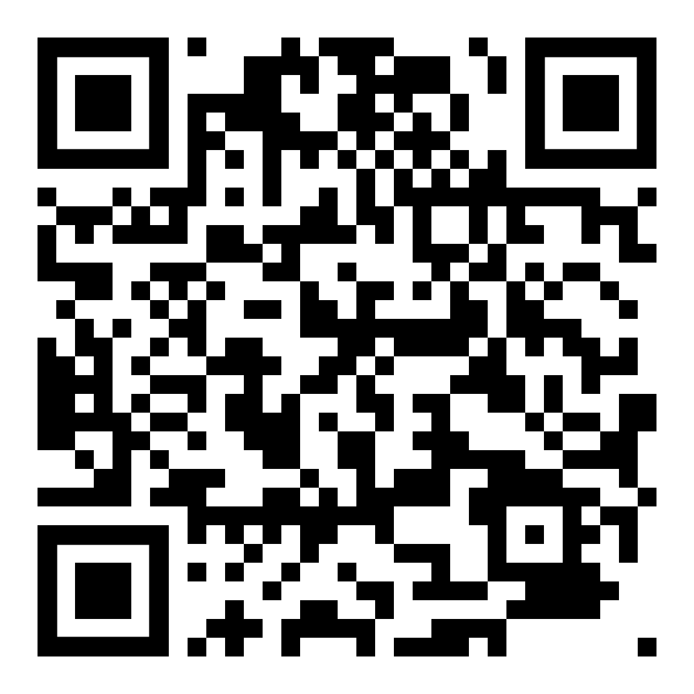
Affect: Intervention
If you’re interested in learning more about Sensory Processing and mental health, take a look at this paper:
https://www.ncbi.nlm.nih.gov/pmc/articles/PMC6370662/
Notes:
We could spend hours talking about and practicing strategies from every one of these modalities
SI – Miller, Reisman, McIntosh & Simon (2001) refer to sensory modulation as, “the capacity to regulate and organize the degree, intensity and nature of responses to sensory input in a graded and adaptive manner. This allows the individual to achieve and maintain an optimal range of performance and to adapt to challenges in daily life” (p. 57). “Sensory approaches include the use of sensory-related assessment tools, sensorimotor activities, sensory modalities, environmental modifications, and assistance in learning how to self-regulate through the process of self-organization and positive change.”

Slide 12
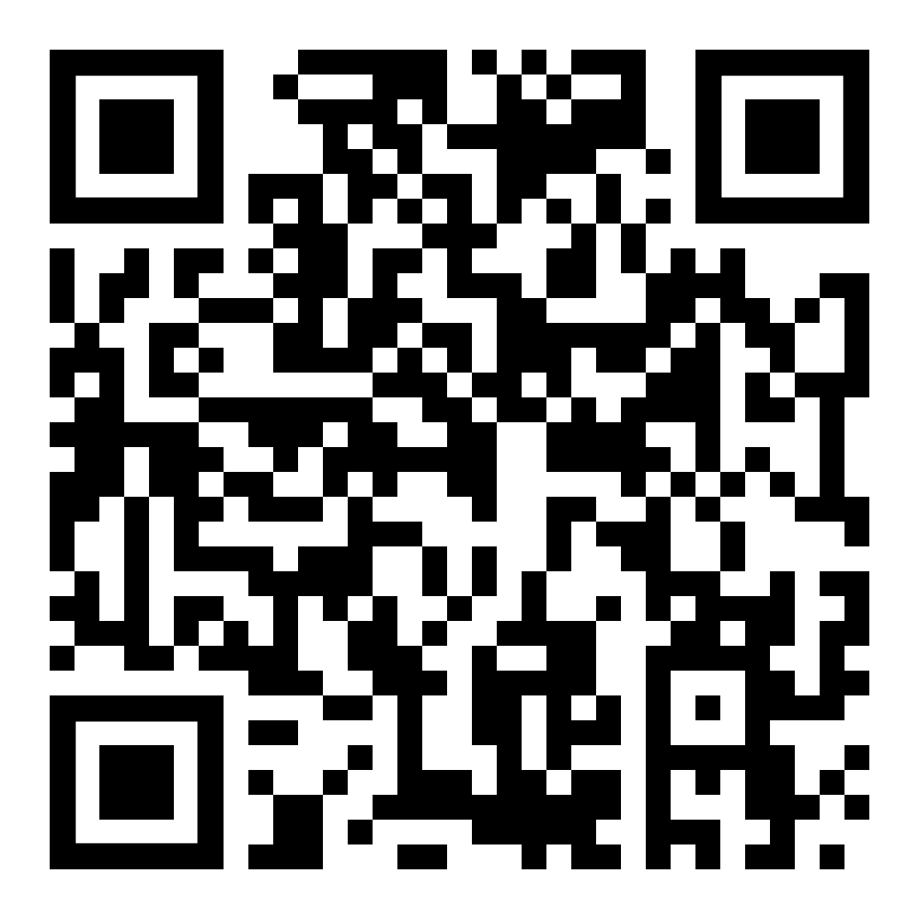
Affect: Intervention
1. Dialectical Behavioural Therapy (DBT):
Goals of this approach: Teach people how to live in the moment, develop healthy ways to cope with stress, regulate their emotions, and improve their relationships with others.
Strategies:
Mindfulness – nonreactive, nonjudgmental awareness of brain and body
Distress Tolerance – radical acceptance, distracting using activities and memories, change body chemistry (movement, temperature, breathing)
Interpersonal Skills Training – assertiveness training, boundary setting
Emotion Regulation – STOP, Opposite Action, ABC, positive self talk
Notes:
DBT: Talk therapy. “Dialectical” means combining opposite ideas, specifically, the ideas of “acceptance” and “change”. Intense emotions.

Slide 13
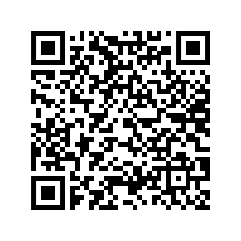
Affect: Intervention
2. Cognitive Behavioural Therapy (CBT)
Goal of this approach: Become aware of inaccurate or negative thinking so you can view challenging situations more clearly and respond to them in a more effective way.
Strategies:
Cognitive restructuring / reframing
Guided discovery
Exposure therapy / successive approximation
Behavioural activation / ADL/IADL activation
Role playing
Progressive Muscle Relaxation (PMR)
Notes:
CBT: Talk therapy. Using thoughts and behaviours to become better aware of, and ultimately change, problematic thoughts and behaviours. Expectations and patterns.
- Guided discovery: Asking open-ended questions, a therapist encourages patients to think about their own thought processes and how they impact their daily lives

Slide 14
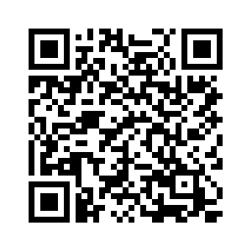
Affect: Intervention
3. Motivational Interviewing (MI)
Goal of this approach: Evoke client’s own motivation for change, in order to help them change something, e.g. substance use, negative thinking, does not want to RTW, ADL/IADL neglect, etc.
Strategies:
Engage / build rapport and trust
Look for and explore “change talk”
Scale of “importance and confidence”
Cost-benefit analysis
Action planning and addressing barriers
Notes:
MI: A collaborative conversation style for strengthening a person’s own motivation and commitment to change.
“Change talk” – The client’s statements about their desire, ability, reasons, and need to make a specific change. I’M LOOKING OUT FOR THIS!
e.g. “I’m just not sure how to start” – prepared, needs planning
”Working is important to me” – early
”I need to get a in a good routine” – early
”I can feel the difference after I’m done breathing” – changing / action
“prepared”, “ready”, “apprehensive”, “unsure”, “fearful”
“Cognitive dissonance” -- a mental conflict that occurs when your beliefs don’t line up with your actions. I’M CAUSING THIS!
Action Planning:
Earlier stages: Behavioural activation – micro goal setting & successful approximation, routine building,

Slide 15
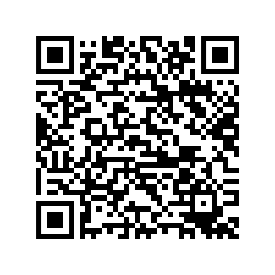
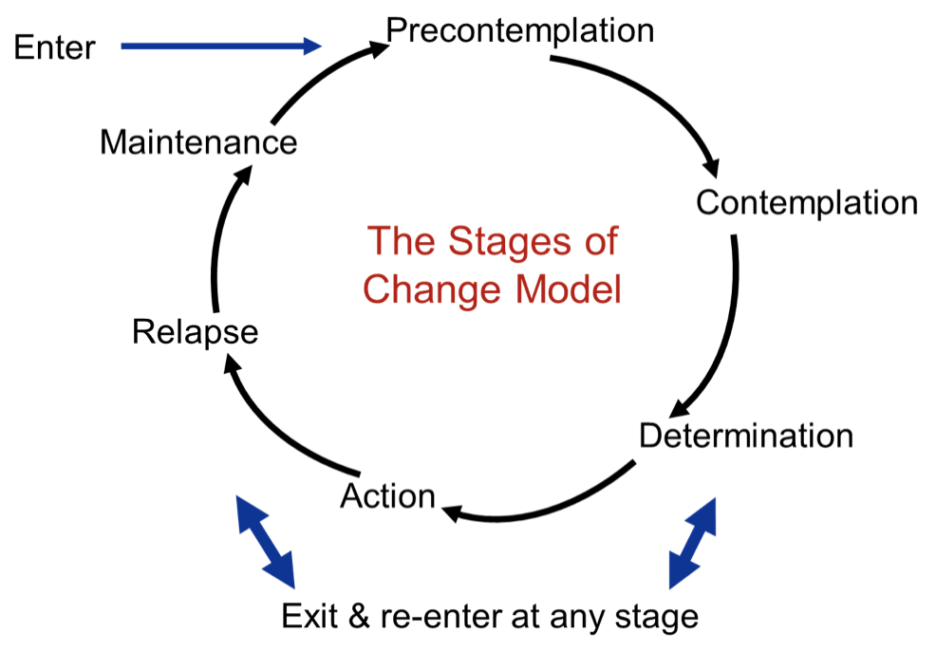
Affect: Intervention
Transtheoretical Model / “Stages of Change” Model
Notes:
- NOT a model specific to MI, but
- MORE applicable to RTW context

Slide 16
Clinical Example
45 year old female client diagnosed with anxiety and major depressive disorder (MDD), experienced the following difficulties at work:
Difficulty concentrating on work
Forgetting deadlines, work procedures
Difficulty completing admin, e.g. emailing staff, calling customers
Episodic mood disturbances: Crying or becoming anxious / panicking episodically throughout workday
General neglect of ADLs and substantial neglect of IADLs

Slide 17
Clinical Example
Assess: (Conduct intake assessment and assess…)
Depressive symptoms, anxiety symptoms
Daily function
Workplace function (if at work)
Job duties
Current coping skills and supports
Work readiness
(Possibly cognition – I find it’s better to ax this functionally at first)

Slide 18
Clinical Example
Findings: (Our assessment revealed…)
“Severe” daily experience of depressive symptoms
“Moderate” daily experience of anxiety symptoms
Disengagement and isolation from social activities
Becomes dysregulated/triggered around mother and brother
“Min-Moderate” work readiness (“Contemplation” stage)
Some coping skills knowledge – some reflective practice and knowledge of CBT
Toxic work environment
Plan: Possible interventions?
Notes:
Possible plan (next slide):
Routine ADL and IADL engagement – behavioural activation with SMART goal setting. Likely some MI as well.
MI re: work readiness – progress client from “Contemplation” or “Preparation” stage to “Action” phase
Learning additional coping skills:
Self-reflection / awareness practices (possible building off CBT knowledge) – CBT informed, thought analysis
Self regulation skills – DBT informed, mindfulness and body awareness
Pair mindfulness with CBT progress muscle relaxation
Boundary setting and assertiveness training for family members
Liaise with CM, and possibly, HR. Also:
Possible interpersonal skills training and/or perspective taking exercises
Possible realty orienting / expectations management

Slide 19
Clinical Example
Plan: Possible interventions:
Routine ADL and IADL engagement – behavioural activation with SMART goal setting. Likely some MI as well.
MI re: work readiness – progress client from “Contemplation” or “Preparation” stage to “Action” phase
Learning additional coping skills:
Self-reflection / awareness practices (possible building off CBT knowledge) – CBT informed, thought analysis
Self regulation skills – DBT informed, mindfulness and body awareness
Pair mindfulness with CBT progress muscle relaxation
Boundary setting and assertiveness training for family members
Liaise with CM, and possibly, HR. Also:
Possible interpersonal skills training and/or perspective taking exercises
Possible realty orienting / expectations management, radical acceptance

Slide 20
Above all else…
All theories / modalities aside, my experiences and book-learning has taught me that simply taking the time to establish a trusting, supportive relationship with the client is massively therapeutic in itself.
Notes:
Hear often: “This is the first time I’ve ever…”
Met with someone
Learned about my mental health and what is happening to me
Have trusted someone with what I’m going through
Felt so alone and scared
The Intentional Relationship Model (IRM): Focuses on the interpersonal events of therapy, and emphasizes the power that therapists have in either reinforcing or inhibiting the client’s motivation through:
1. Advocating: Acting to ensure that the clients have resources needed to participate in occupations;
2. Collaborating: Facilitating autonomy and the clients’ ownership of therapy process;
3. Empathizing: Understanding and validating the clients’ lived experience;
4. Encouraging: Fostering hope and willingness to engage;
5. Instructing: Providing clear expectations and explanations about the therapy process; and
6. Problem solving: Use of reasoning and strategic questions to identify solutions.

Slide 21
Many times getting “buy-in” is half the battle!
This is why it’s so important to take the time to understand the client and answer the many “whys” they might have.
If we don’t know why we’re feeling the way we are and why doing something will help help us, we simply will not do it.
Notes:
E.g. If we don’t know why mindfulness will help our anxiousness, we won’t do it, especially during hard times – we need to understand that anxious thinking has us thinking retroactively and prospectively, which takes us “away from the present”, which ultimately locks us in “scenario” thinking – and all the emotions that come along with this! (Think of an embarrassing moment in your life…..is it fun to stay here? What emotions do you get? haha)

Slide 22
What I want you to remember…
OTs use meaningful activities (“occupations”) to assess AND rehabilitate.
OTs have extensive training in understanding and assessing various factors which could be impacting a client’s function – mental, physical, cognitive, social factors, etc.
Mental health OTs can use evidence-based treatment modalities such as CBT, DBT, and MI to help our clients regain their independence.

Slide 23
Roadmap – revisited
Today, we’ve covered:
What is OT?
What role the OT has in supporting their client’s mental health
Common assessments used by mental health OTs
Common interventions used by mental health OTs
Application of assessment and intervention techniques to a clinical example

Slide 24
Resources / References
Description of CBT: https://www.mayoclinic.org/tests-procedures/cognitive-behavioral-therapy/about/pac-20384610
Description of DBT: https://www.verywellmind.com/dialectical-behavior-therapy-1067402#citation-9
DBT tools: https://dbt.tools
DBT Peer-Reviewed & Published Randomized Controlled/Comparative Trials: https://behavioraltech.org/wp-content/uploads/2018/04/RCT4ModesResearchDatatoDate2016.06.28-new-logo.pdf
Description of MI: https://motivationalinterviewing.org/understanding-motivational-interviewing
Description of sensory modulation: https://www.ot-innovations.com/clinical-practice/sensory-modulation/the-sensory-modulation-program-for-adolescents-adults/
SI/SP, neurophysiology, and mental health: https://www.ncbi.nlm.nih.gov/pmc/articles/PMC6370662/

Slide 25
Resources / References
CAOT: “What is OT?”: https://caot.ca/site/about/ot?nav=sidebar&banner=1
“The Intentional Relationship”: Taylor, R. R. (2008). The intentional relationship: Outpatient therapy and use of self. FA Davis. https://ottheory.com/therapy-model/intentional-relationship-model-irm
CBT Techniques: 25 Cognitive Behavioral Therapy Worksheets: https://positivepsychology.com/cbt-cognitive-behavioral-therapy-techniques-worksheets/
17 Motivational Interviewing Questions and Skills: https://positivepsychology.com/motivational-interviewing/

